Slide 1

Luxelle – Premium Fashion & Lifestyle
Vidhyadhan Charitable Trust
SMT Z.S Patel College of Computer Application
Affiliated to, Veer Narmad South Gujarat University, Surat
Presented By. | Manani Suraj Vinodbhai - 5240 | Mandaliya Raj Manojbhai - 5241
Guided By. | Dhvani Ma’am
Group No. | 11

Slide 2

Project Overview & Mission
Designed for luxury fashion brands and boutique markets
Delivers a seamless and engaging digital shopping experience
Connects premium brands with modern digital customers
Improves both user experience and backend management
Simplifies online shopping while maintaining premium feel

Slide 3
Luxury - First Design Philosophy
Clean & Minimal
Highlight products with space and elegance.
High-Quality Visuals
Rich imagery and careful spacing.
Micro-Interactions
Smooth animations improve engagement.
Luxury Typography
Curated fonts & colors reflect exclusivity.

Slide 4
Problem Statements
Most e-commerce platforms lack premium & modern design.
Managing product variations (size, color, material) is complex
Poor UX leads to high cart abandonment rates.
Systems fail to scale with growing
users and product data
No solution combining performance with design quality

Slide 5
Technology Stack — MERN
Mongo DB
Database
Flexible, Scalable, NoSQL storage.
Express.js
Backend
Secure & Efficient REST APIs.
Angular
Frontend
Dynamic, Component – based UI.
Node.js
Runtime
High Performance Server – Side Ops.

Slide 6

Frontend Development — Angular
Structured, component-based architecture for maintainability
Fast, dynamic page updates without full reload
Client-side routing ensures smooth navigation across pages
Modular design improves code scalability
Delivers a fast, modern, and interactive user interface

Slide 7
UI Design & Styling
Tailwind CSS
Fast, Utility – First styling Framework.
Fully Responsive
Adapts Seamlessly to all screen size.
Consistent Layout
Spacing & Typography rules throughout.
Modern Trends
Gradients, Shadows, & Depth effects.
Luxury Aesthetic
Elevated visual feel for Premium brands.

Slide 8
Backend & API System
RESTful APIs for communication between client and server
Middleware handles authentication, logging, and validation
JSON used for fast and efficient data transfer
Business logic separated for better maintainability
Backend ensures security, scalability, and performance
CLIENT
REST API
MIDDLEWARE
DATABASE

Slide 9
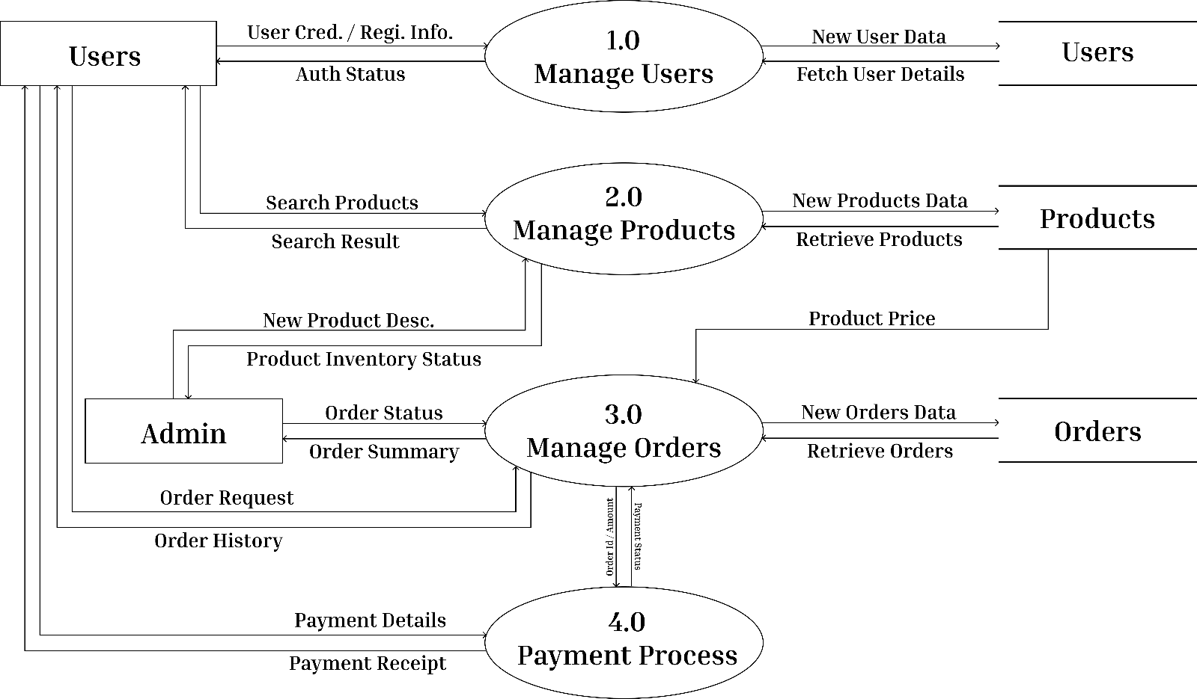
DFD LEVEL - 1

Slide 10
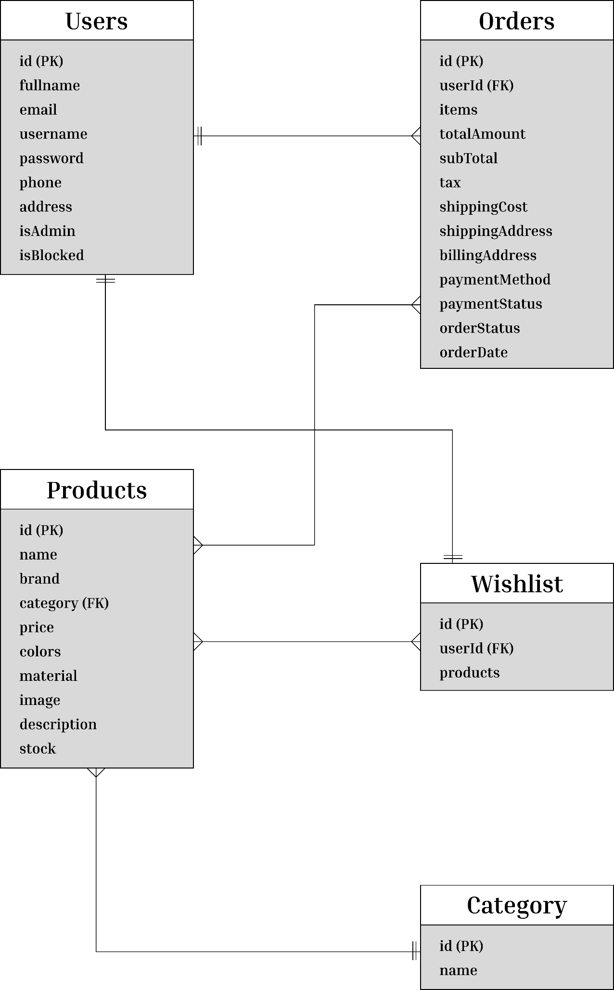
ER DIAGRAM

Slide 11
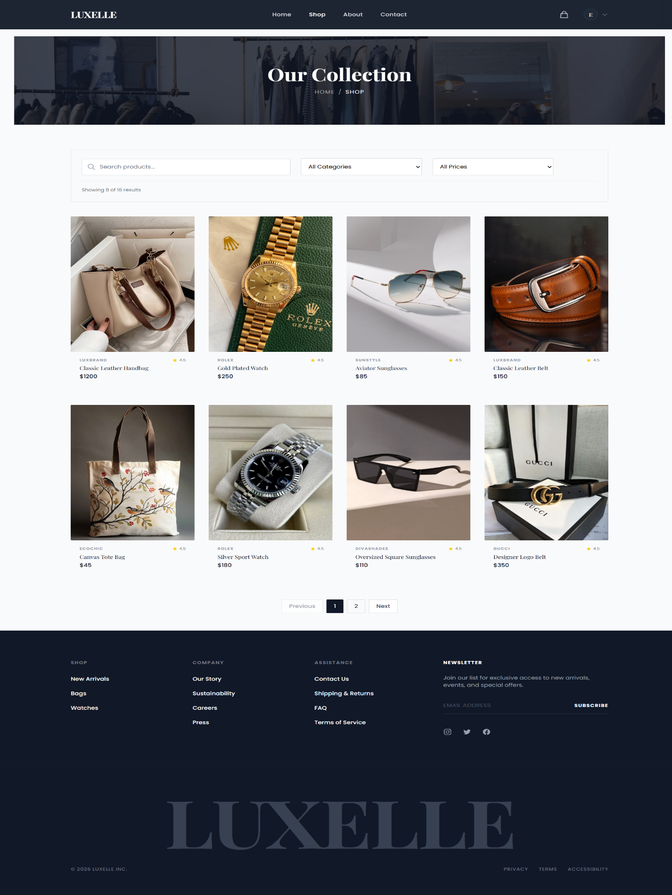
Product Discovery
Browse products through categories and curated collections
Detailed product info with high-quality images per listing
Rich product details for informed purchase decisions
Real-time stock availability displayed prominently
Smooth, intuitive browsing experience throughout

Slide 12
Advanced Filtering
$
Price Range
★
Brand
Multiple filters applicable simultaneously
Interactive sliders for easy range selection
Helps users quickly find desired products
Improves overall shopping efficiency
≡
Category
◉
Color

Slide 13
Smart Search
Search by product names, brands, or keywords
Fast and accurate results delivered instantly
Suggestions shown to improve search experience
Search history helps revisit previous queries
Ensures quick and easy product discovery
Search Luxury Fashion
Designer Bags
Silk Scaraves
Premium Watches

Slide 14
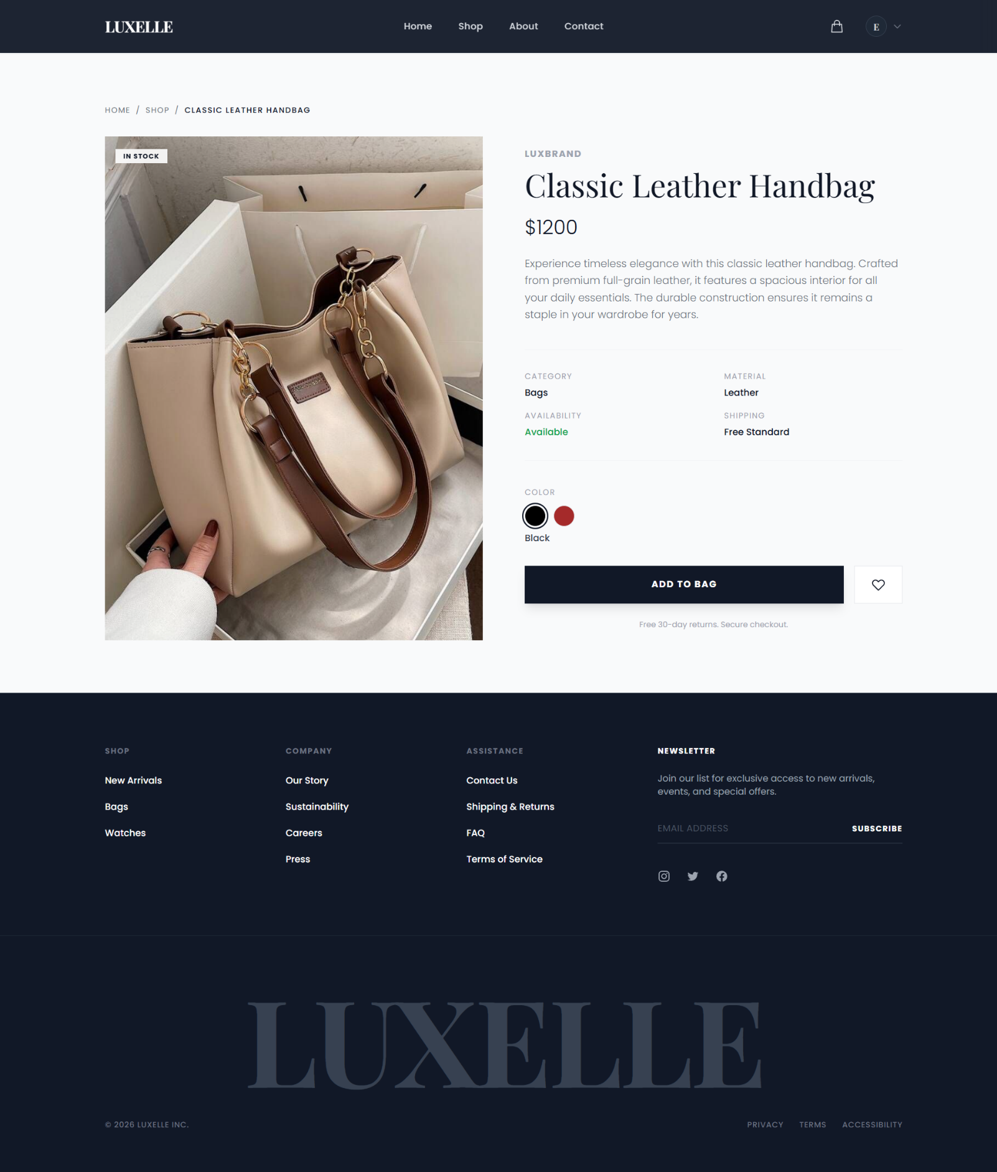
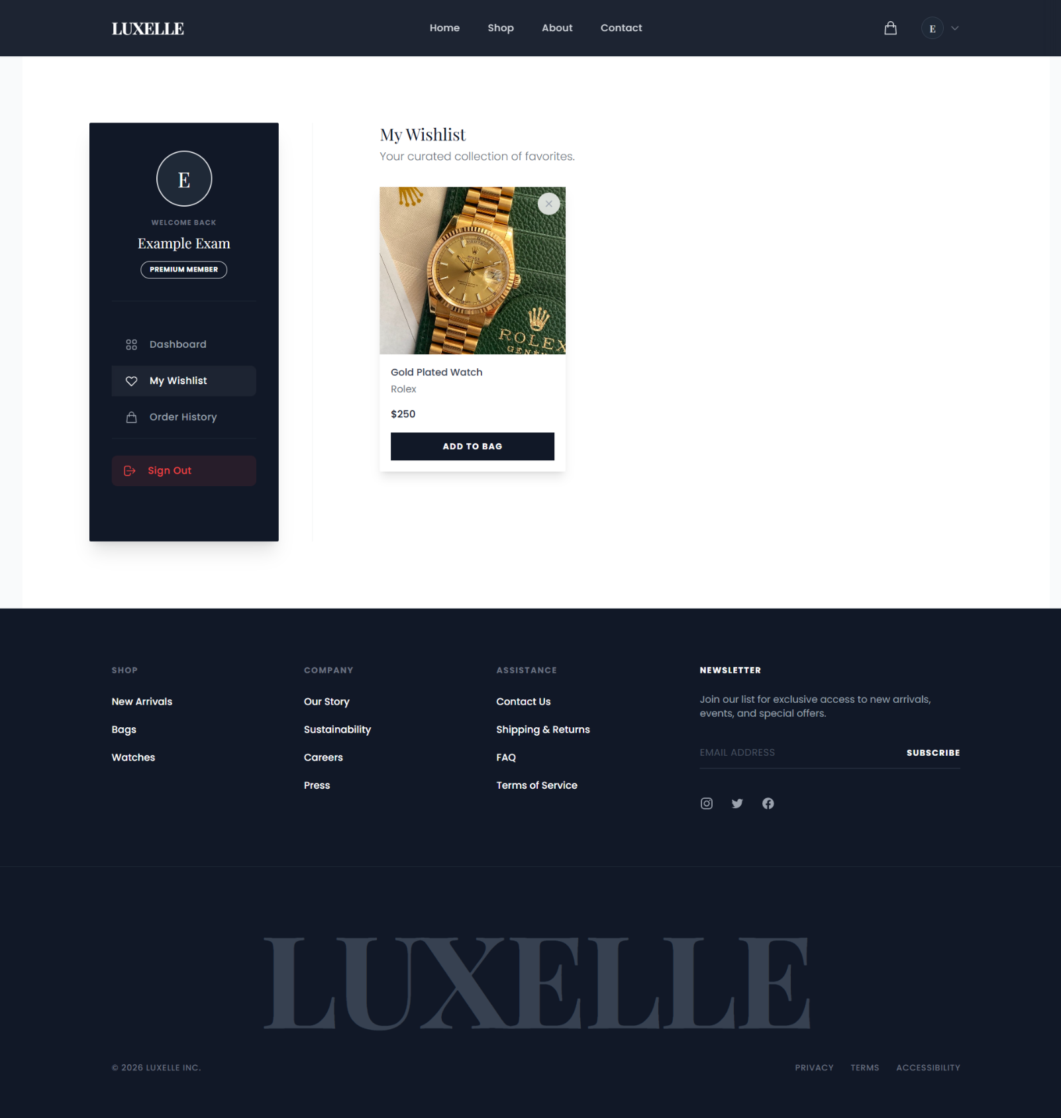
Product Details & Wishlist Page

Slide 15
Order Management
View all past and current orders in one place
Each order shows items, quantities, and pricing
Order status updated in real-time
Track purchases and complete transaction history
Placed
Processing
Shipped
Delivered

Slide 16
Wishlist System
Save products for future purchase with one click.
Wishlist persists across sessions and devices.
Move items to cart instantly from wishlist view.
Low-stock alerts notify users about saved items.

Slide 17
User Dashboard
Displays user profile and account information.
Quick access to orders, wishlist, and settings.
Easy update of personal details and preferences.
Central control panel for all user activities.

Slide 18
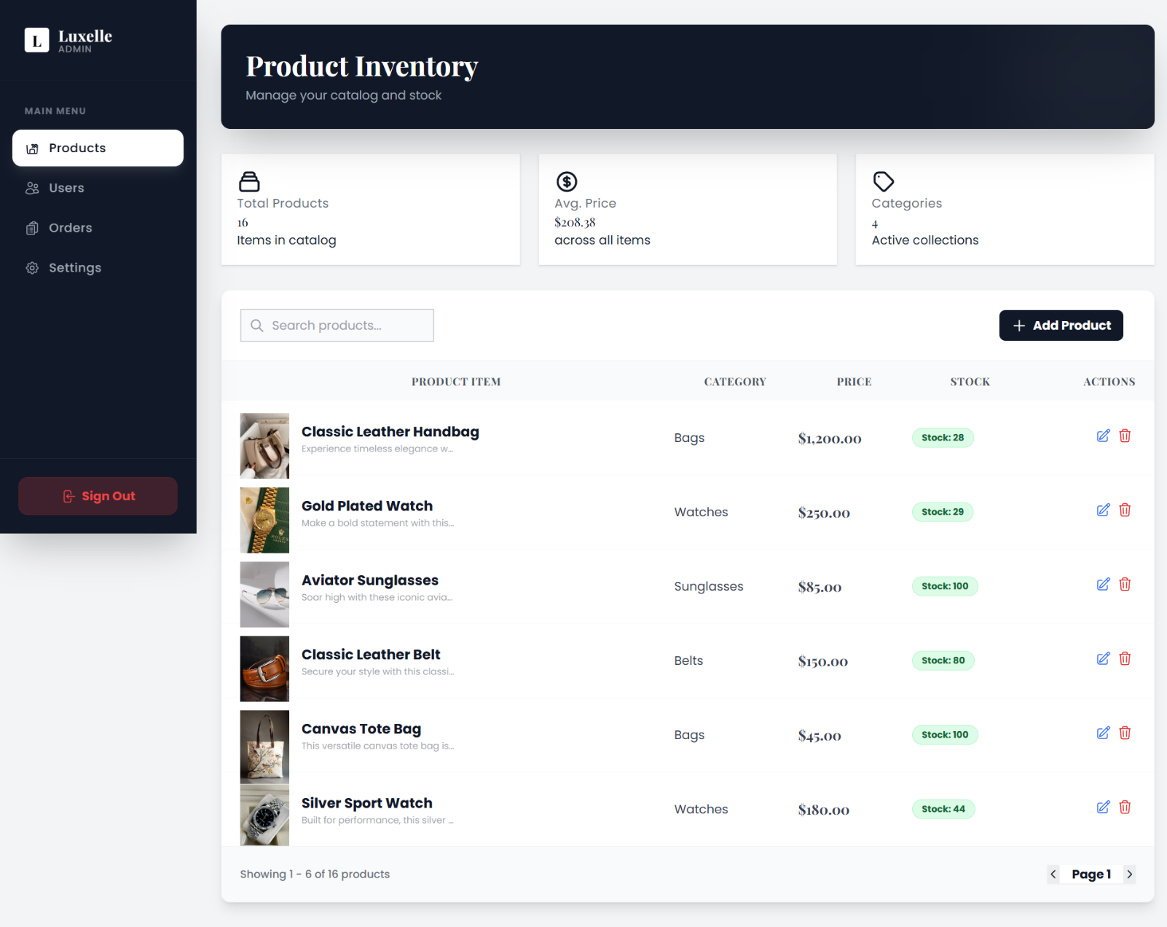
Admin Dashboard

Slide 19
Security Features
Password Encryption
Password Stored using bycrypt hashing.
JWT Authentication
Secure, Stateless User Sessions.
Input Sanitization
Prevents XSS & injection attacks.
Error Logging
System errors monitored & logged.

Slide 20
Database — Products Collection
Field | Type | Description
name | String | Product name & brand
category | String | Product category
price / discount | Number | Pricing details
stock | Number | Real-time inventory
images | Array | Product photo URLs
variations | Object | Size, color, material

Slide 21
Database — Users Collection
Field | Type | Description
name / email | String | User identity fields
password | String | Encrypted with bcrypt
role | String | Admin or Customer
wishlist | Array | Saved product IDs
addresses | Array | Multiple shipping addresses

Slide 22
Database — Orders Collection
Field | Type | Description
userId | ObjectId | Links order to user
products | Array | Items, quantity & price
status | String | Order lifecycle stage
shippingInfo | Object | Delivery address details
createdAt | Date | Timestamp of order

Slide 23
Future Scope
Advanced Payments
Integration of Stripe, Razor-Pay & more gateways.
Reviews & Ratings
User-generated product reviews and star ratings.
AI Recommendations
Personalized suggestions based on behavior.
Dark Mode
Full dark theme toggle for user preference.
Scalability
Cloud-native deployment for global growth.

Slide 24
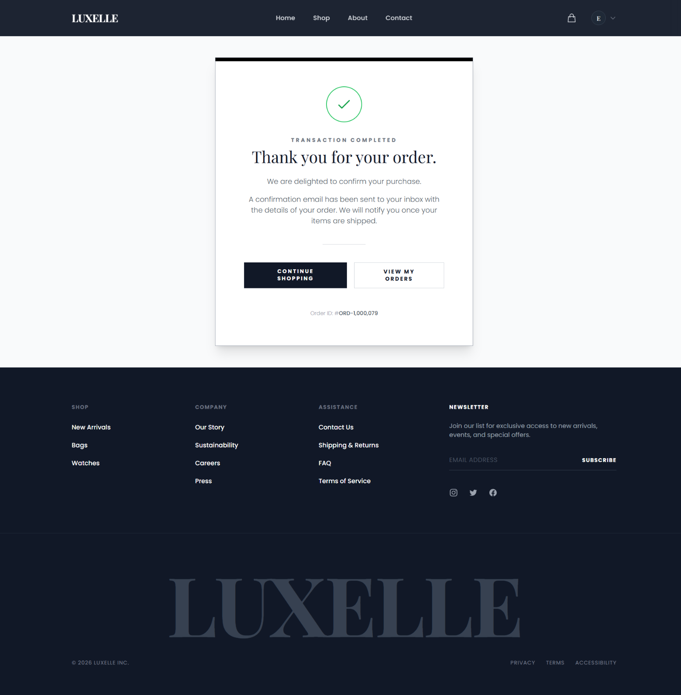
Conclusion
Complete premium fashion e-commerce solution using modern web technologies
Elegant UI design combined with a strong and scalable backend architecture
Smooth, secure, and engaging shopping experience for every user
Scalable platform capable of real-world business requirements
A perfect blend of technology, performance, and luxury design

Slide 25
References
MongoDB
https://www.mongodb.com/cloud/atlas
Node.js
https://nodejs.org/
TailwindCSS
https://tailwindcss.com/
Angular
https://angular.dev/

Slide 26
Thank You!
Do you have any questions?

